Slide 1
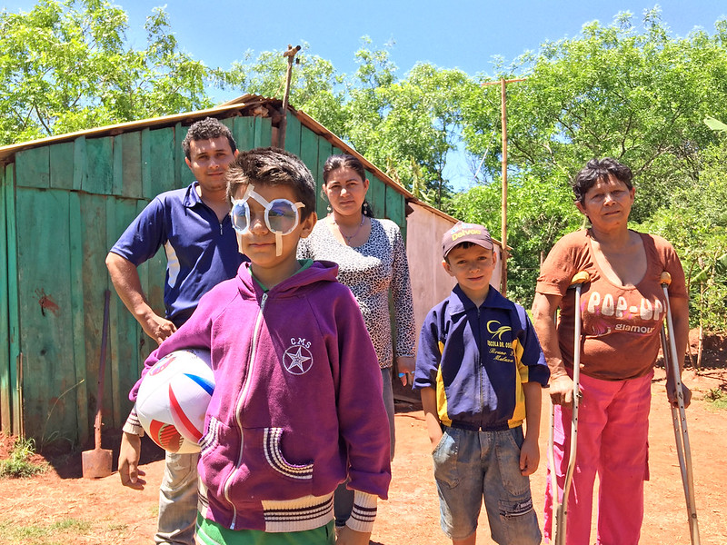

World Report on Vision

Slide 2
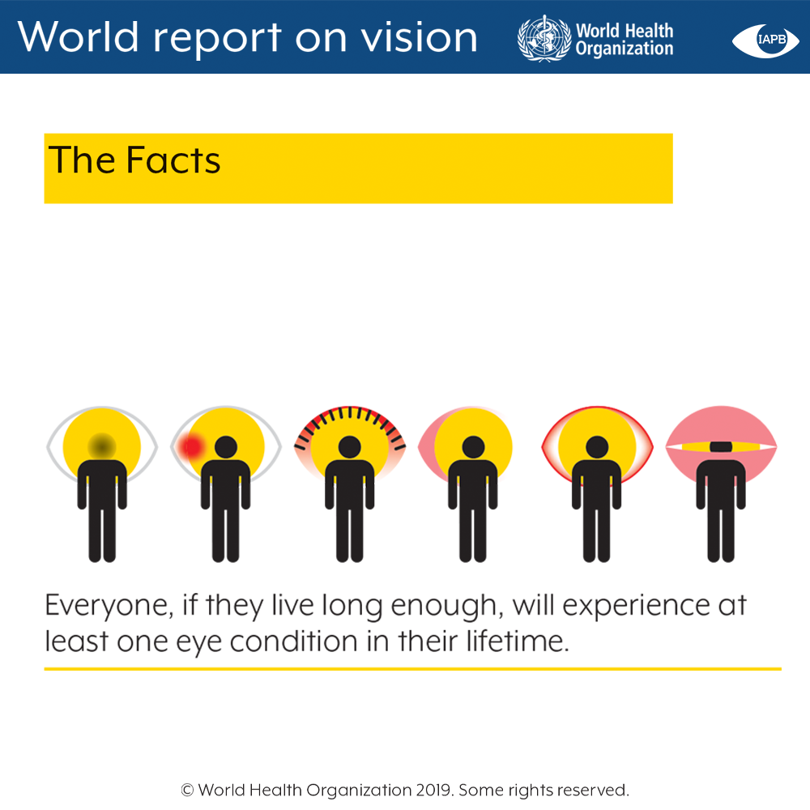

Slide 3
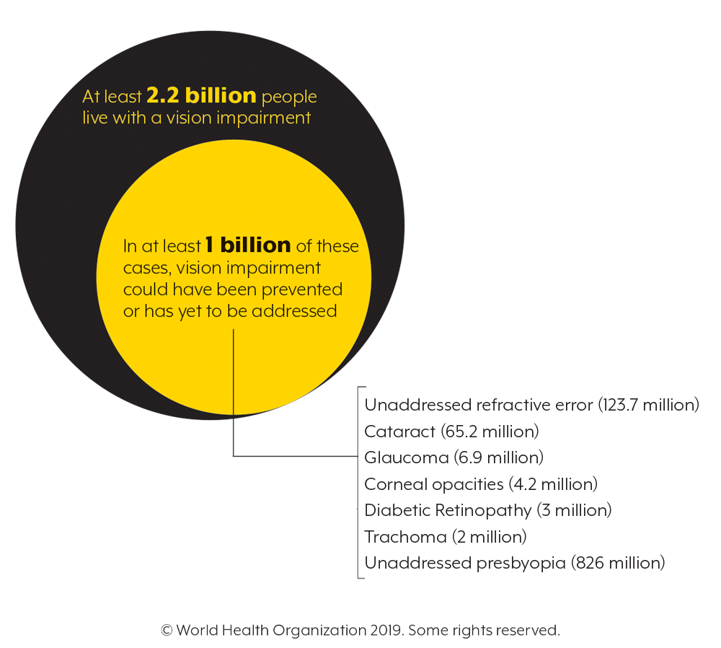

Slide 4
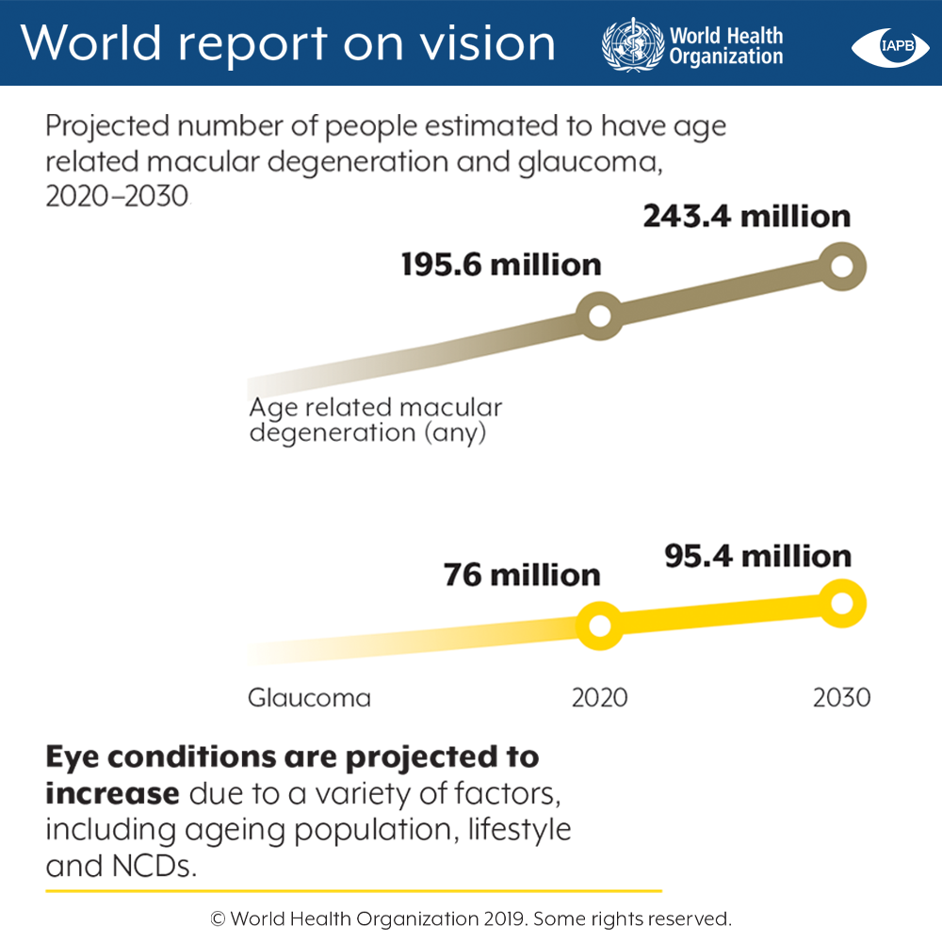

Slide 5
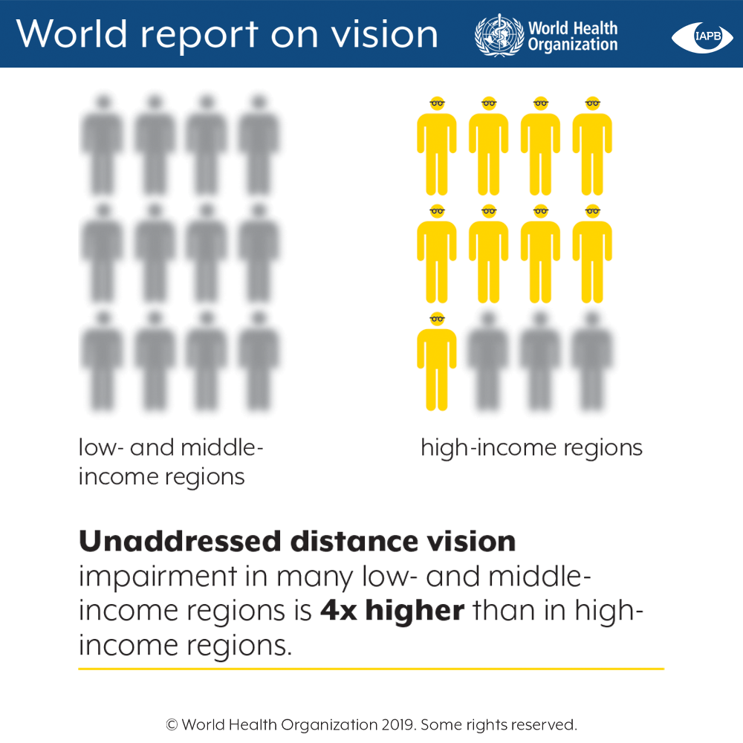

Slide 6
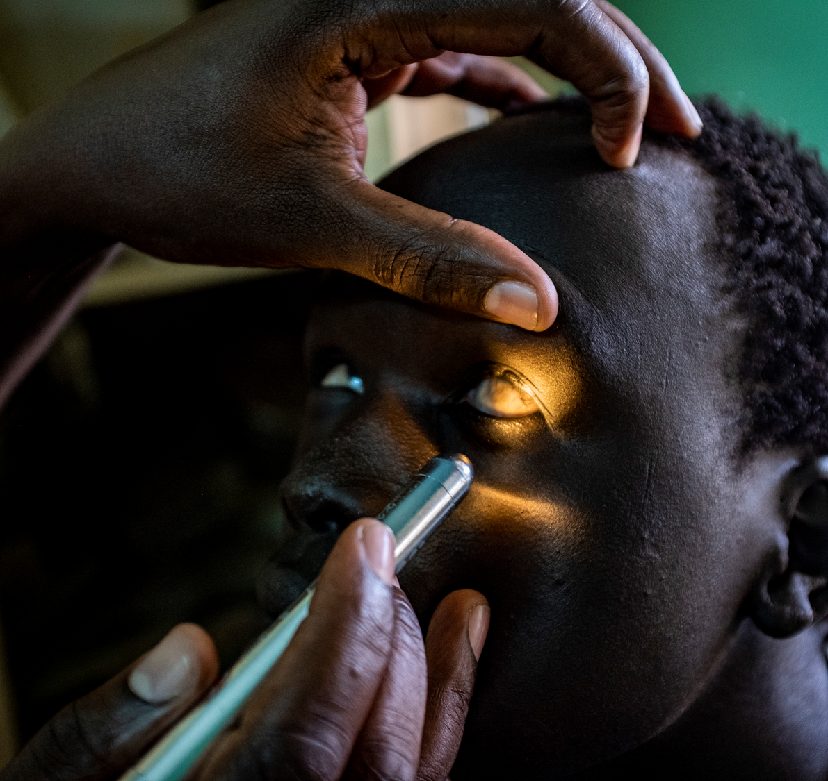
Lack of ACCESS to care
© World Health Organisation 2019. Some rights reserved

Slide 7
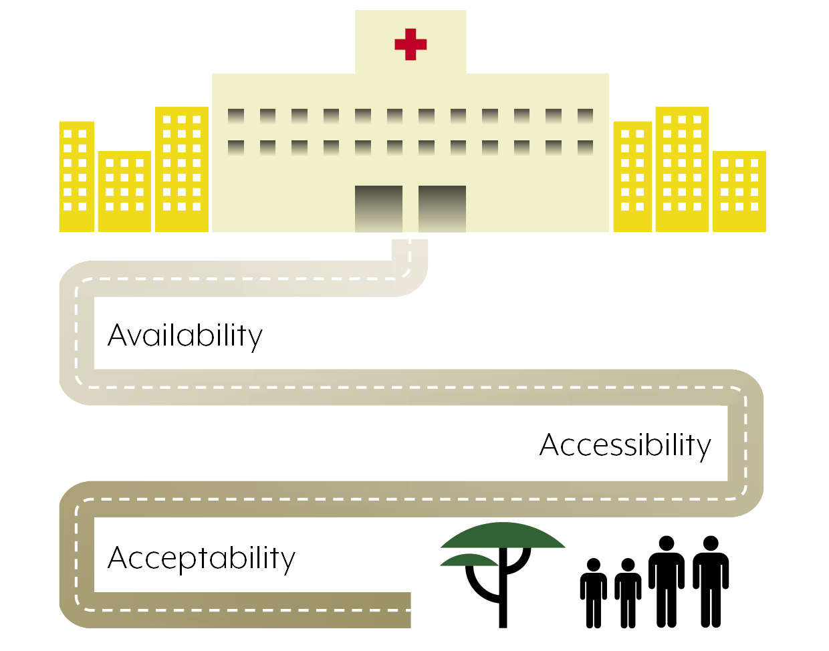
Lack of ACCESS to care
© World Health Organisation 2019. Some rights reserved

Slide 8
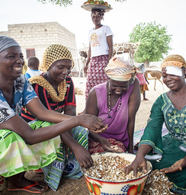
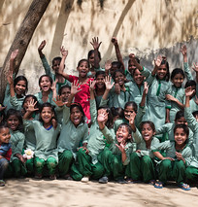
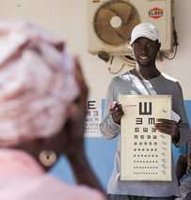
Productivity
Education
Road traffic accidents
Productivity improves by up to 20-30%
Impact equivalent to up to ½ a year additional schooling
30% of those involved in RTAs have vision impairment

Slide 9
Eye care interventions
Lack of ACCESS to care
Effective interventions are available for health promotion, prevention, treatment and rehabilitation to address the entire range of needs associated with eye conditions and vision impairment across the life course.
Some are among the most feasible and cost-effective of all health care interventions to implement.
© World Health Organisation 2019. Some rights reserved

Slide 10
Lack of Integration
Lack of ACCESS to care
Vertical programmes
Lack of coordination with the private sector
Uncoordinated and unregulated workforce
  8/24 countries do not recognize optometry as a profession or do not have educational requirement
Eye-care is not part of the health information system
© World Health Organisation 2019. Some rights reserved

Slide 11
National overarching development/strategic plan
AGEING
MENTAL HEALTH
ANTI-MICROBIAL RESISTENCE
HIV/AIDS
NCDs
Health Sector Strategic Plan
Maternity & Child Health
Eye care
If eye care is not part of the health sector strategic plan, it will not be prioritized
© World Health Organisation 2019. Some rights reserved

Slide 12
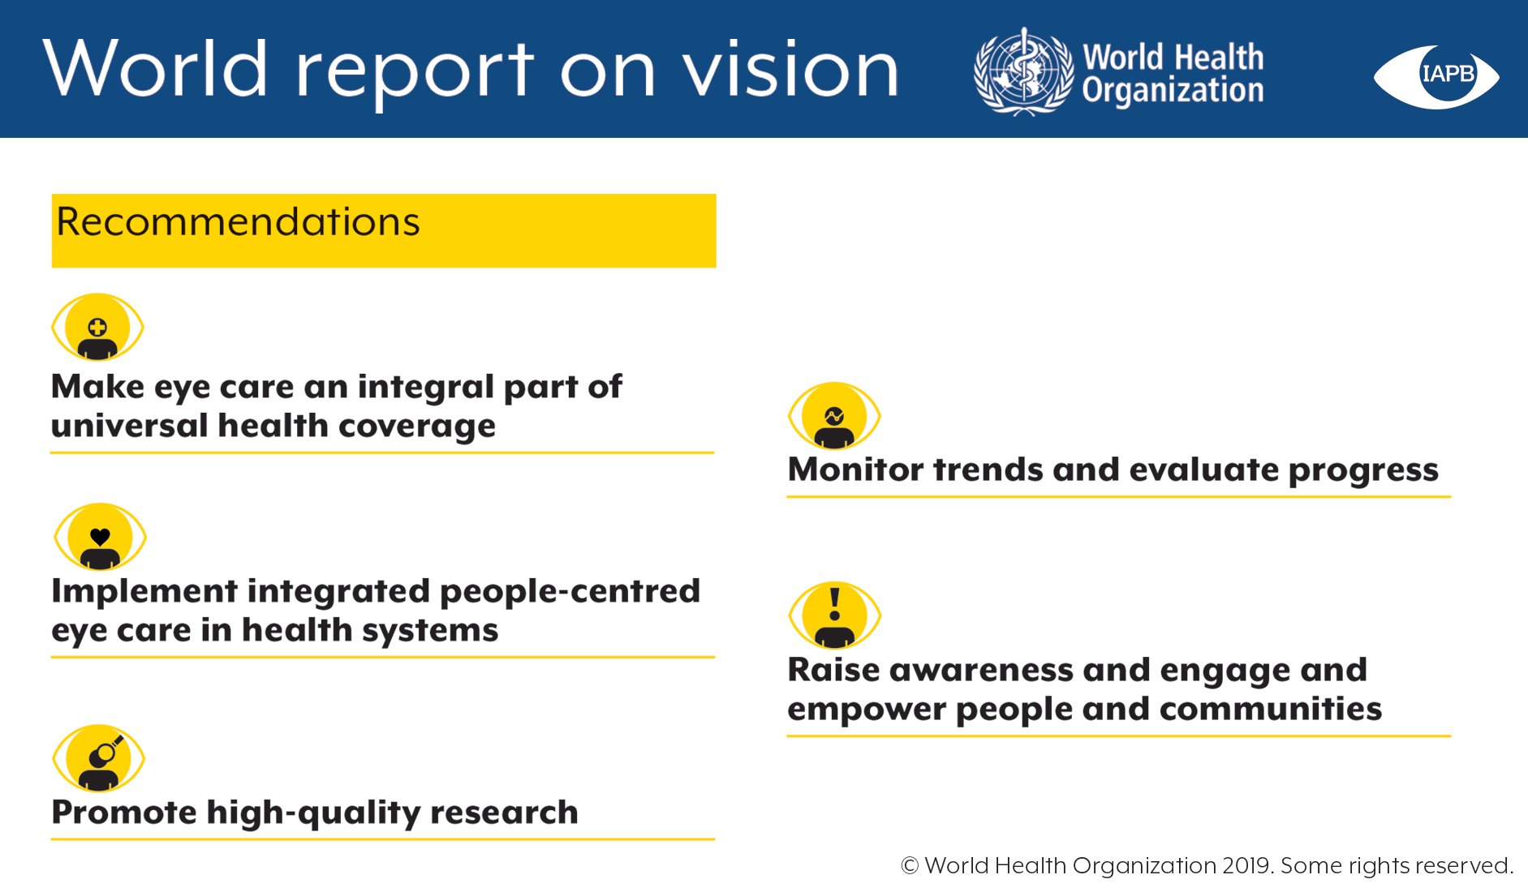

Slide 13
Integrated People Centred Eye Care
Are managed and delivered so that people receive a continuum of eye care interventions covering promotion, prevention, treatment and rehabilitation;
Address the full spectrum of eye conditions according to their need;
Are coordinated across the different levels and sites of care within and beyond the health sector; and
Recognize people as participants and beneficiaries of these services, throughout their life course.
© World Health Organisation 2019. Some rights reserved
Notes:
Start with
The figure of all levels of care:
Strengthen primary health care
Refraction for adults
Diabetic rethinopathy
Cataract
It will require good referral systems and good coordination
Health sytem approach
Integration in health strategic plans
Financing
Accorsing to the need and coordination – health information systems
Workforce

Slide 14
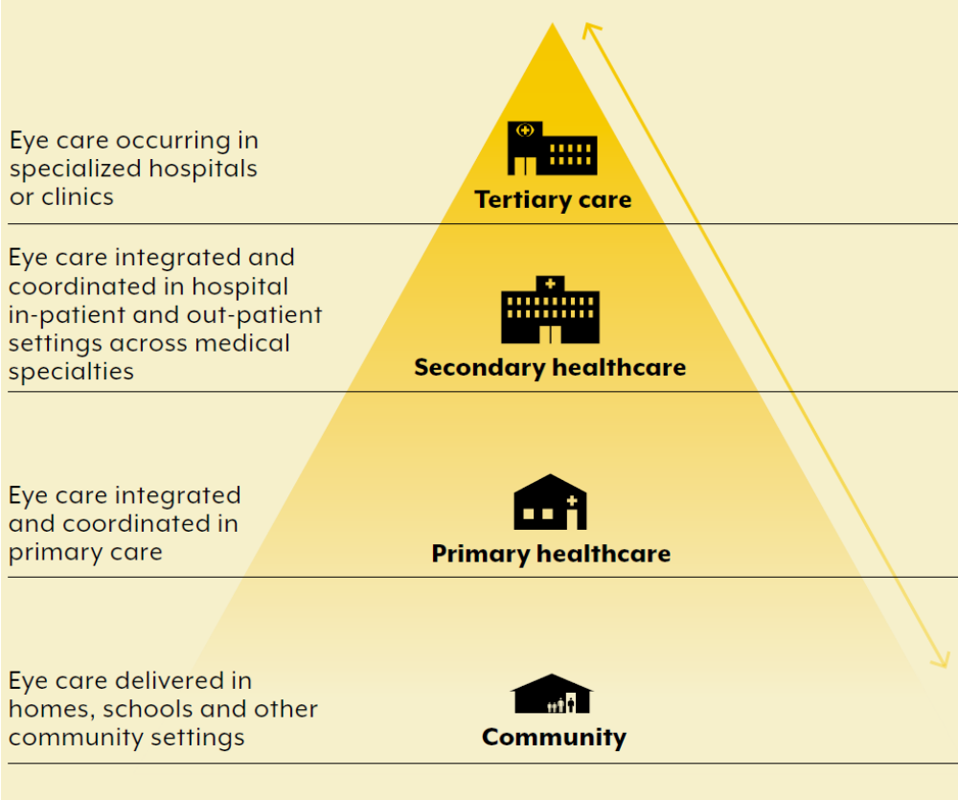
Strengthen all levels of care
Workforce
Equipment & consumables
Assistive products
Infrastructure
$
© World Health Organisation 2019. Some rights reserved

Slide 15
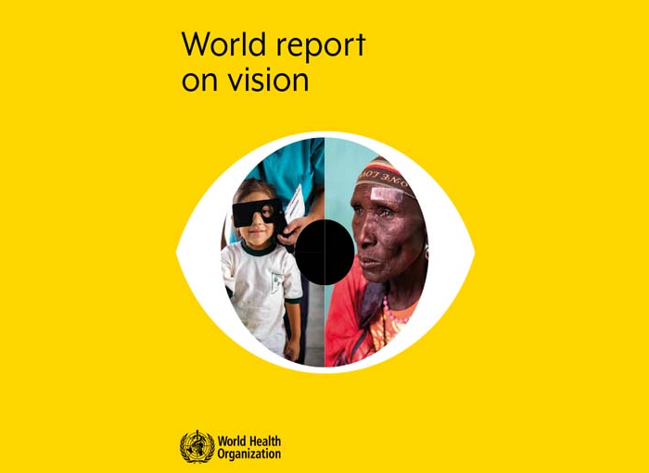
World Report on Vision
WHO’s first ever World Report on Vision
Strategic framework: guide action at national, regional and global level
Critical moment to inform and persuade global leaders about the magnitude and unacceptability of vision loss globally.

Slide 16
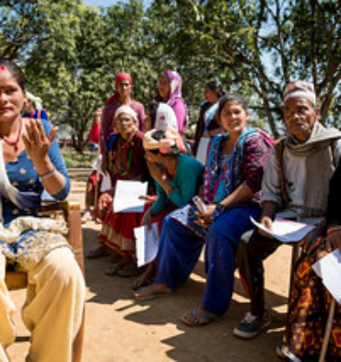
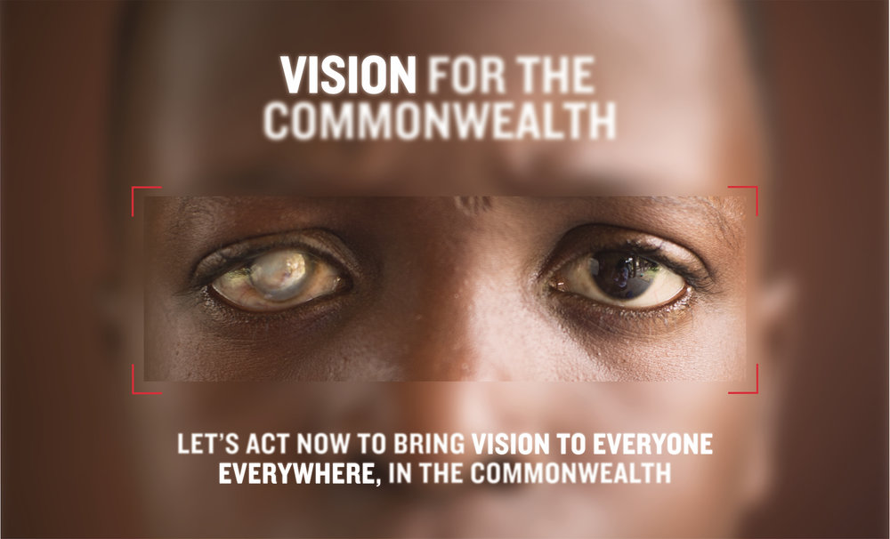

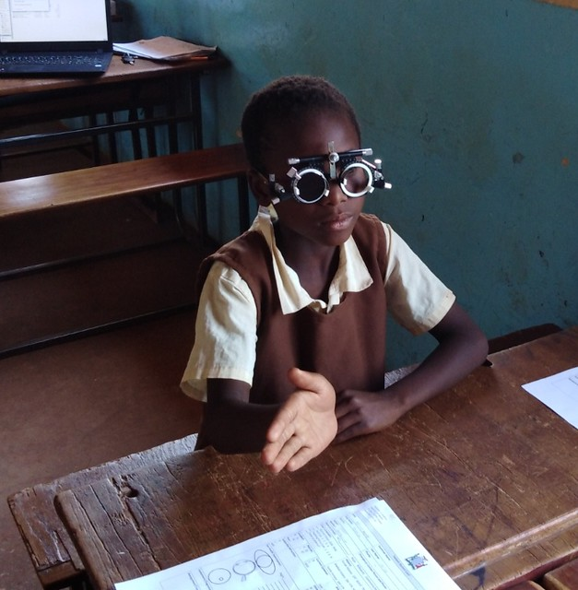
CHOGM RWANDA
COUNTRY LAUNCHES
UN FRIENDS OF VISIONS
WORLD HEALTH ASSEMBLY RESOLUTION

Slide 17


