Slide 1


Vision 2020 Australia
2nd National Eye Health Survey
Australian Eye Health Study
Paul Mitchell AO, MBBS MD PhD FRANZCO FRCOphth FAFPHM
Professor, University of Sydney Dept Ophthalmology, Westmead Hospital, Westmead, Sydney
Director, Centre for Vision Research, Westmead Institute for Medical Research
Sydney West Retina, Westmead, Sydney

Slide 2
Investigators in Australian Eye Health Study
Lead investigator: Professor Paul Mitchell (USYD)
Co-investigators:
  A/Prof Gerald Liew (USYD)
  Prof Bamini Gopinath (MQU)
  Prof Lisa Keay (UNSW)
  A/Prof Gian Luca Di Tanna (TGI)
  Ms Colina Waddell (BHF)
  Mr Tim Fricke (BHF)

Slide 3
Australian Population-based Eye Surveys
Blue Mountains Eye Study, B1992-4; 5y 1997-9; 10y 2002-4; 15y 2007-9
Melbourne Vision Impairment Project
B 1993-4; 5y 1998-9
National Indigenous Eye Health Survey 2008
National Eye Health Survey, 2015-16
Childhood eye surveys

Slide 4
National Eye Health Survey (UniMelb)
Foreman, Keel, Xie, van Wijngaaarden, Crowston, Taylor, Dirani
Recruitment occurred from 3/2015 to 4/2016
Doorknock census, 85.7% of eligible enrolled
Examinations of 3,098 non-Indigenous aged 50+ and 1,738 Indigenous aged 40+ (4,836) - overall examination rate 71.5%
VI – age-adjusted prevalence 4.6% vs 13.6%
Blindness – age-adjusted prevalence 0.12% vs 0.36%
453,000 (433K, 18K) Australians had VI/ blindness; M/F same
Main causes VI uncorrected RE (62%, 63%) and cataract (14%, 20%); over half of 5 main causes not prev. diagnosed
NHMRC recommended DR exams 78% vs 53%
Cataract surgery rate 88% vs 61%

Slide 5
NEHS1: publications (26+ to date…)
Sampling and recruitment methodology for a national eye health survey of Indigenous Australians. Aust N Z J Public Health. 2010
Sampling methodology and site selection in the National Eye Health Survey: an Australian population‐based prevalence study. Clin. Exp. Ophthalmol. 2016
Recruitment and Testing Protocol: in the National Eye Health Survey: A Population-Based Eye Study in Australia. Ophthal. Epidemiol. 2017
Participant referral rate in the National Eye Health Survey (NEHS). PLOS ONE. 2017
Prevalence of Age-Related Macular Degeneration in Australia: The Australian National Eye Health Survey. JAMA Ophthalmol. 2017
The Prevalence of Diabetic Retinopathy in Australian Adults with Self-Reported Diabetes: The National Eye Health Survey. Ophthalmology. 2017
The Prevalence of Self-Reported Diabetes in the Australian National Eye Health Survey. PLOS ONE. 2017
Treatment coverage rates for refractive error in the National Eye Health survey. PLOS ONE. 2017
The Prevalence of Self-Reported Stroke in Aust. National Eye Health Survey. J. Stroke Cerebrovasc. Dis. 2017
Adherence to diabetic eye examination guidelines in Australia: National Eye Health Survey. Med. J. Aust. 2017
The prevalence of vision loss due to ocular trauma in the Australian National Eye Health Survey. Injury. 2017
The validity of self-report of eye diseases in participants with vision loss in the National Eye Health Survey. Sci Rep. 2017

Slide 6
The Prevalence and Causes of Vision Loss in Indigenous and Non-Indigenous Australians: The National Eye Health Survey. Ophthalmology 2017
Prevalence of trachomatous trichiasis in Australia: the National Eye Health Survey. Clin. Exp. Ophthalmol. 2017
Prevalence of retinal vein occlusion in the Australian National Eye Health Survey. Clin. Exp. Ophthalmol. 2017
Cataract surgery coverage rates for Indigenous and non‐Indigenous Australians: the National Eye Health Survey. Med. J. Aust. 2017
Population-based assessment of visual acuity outcomes following cataract surgery in Australia: the National Eye Health Survey. BJO. 2018
Prevalence and characteristics of choroidal nevi: the Australian National Eye Health Survey. Clin. Exp. Ophthalmol. 2018.
Prevalence and associations of presenting near-vision impairment in the Australian National Eye Health Survey. Eye. 2018
Prevalence and Causes of Unilateral Vision Impairment and Unilateral Blindness in Australia: The National Eye Health Survey. JAMA Ophthalmol. 2018
Utilization of eye health‐care services in Australia: the National Eye Health Survey. Clin. Exp. Ophthalmol. 2018.
The prevalence of visually significant cataract in the Australian National Eye Health Survey. Eye. 2019
Prevalence of glaucoma in the Australian National Eye Health Survey. BJO. 2019
Prevalence, associations and characteristics of severe uncorrected refractive error in the Australian National Eye Health Survey. Clin. Exp. Ophthalmol. 2019
Future burden of vision loss in Australia: Projections from the National Eye Health Survey. Clin. Exp. Ophthalmol. 2020
Prevalence and associations of non-retinopathy ocular conditions among older Australians with self-reported diabetes: The National Eye Health Survey. Int. J. Ophthalmol. 2020

Slide 7
Aims of the AEHS
To obtain comparable prevalence data to that collected in NEHS1
To build on the seminal NEHS1 to determine the current burden of eye disease in Australia and establish a time series for the purposes of trend analysis
To address key issues raised in NEHS1
  Greater representativeness of the population via (hopefully) higher examination rates, particularly in major metropolitan areas, where most Australians live;
  Improved eye disease detection, using pupil dilation plus new non-invasive, objective imaging technologies (OCT anterior segment, macula, optic disc, ultra-wide field retinal photography plus OCT-angiography), in order to fully image the posterior and near peripheral retina; and
  Additional data collection, informing links between vision loss/ eye disease with critical health/ social outcomes; optional data linkage consent

Slide 8
Issues from NEHS – neovascular AMD (nAMD)
nAMD remains leading cause of irreversible blindness in Australia/ highest cost of treating any eye disease (PBS/ MBS)
NEHS Projections (2016) indicate 54,000 Australians with late AMD, including 13,500 nAMD (1/4 differed from other studies)
PBS data (2014): 37,000 persons treated for nAMD
PBS data (2017): 51,000 persons treated for nAMD
Likely only half of those with nAMD are treated at any time because of advanced scarring, out-of-pocket costs, etc
Suggests under-estimate – causes: imaging, low exam rate, persons already under treatment not feeling need to attend
All of these issues could potentially be addressed in new study

Slide 9
Methodology of the AEHS
Selection of SA2’s to represent State/ Australian population to enable recruitment of 3,250 N-I and 1,750 I
Selection of number of SA1’s within each SA2, in order to provide these targets – some SA2’s will include more SA1’s
Community publicity to selected SA2’s including to all eye care and general practitioners
Door-to-door census of selected SA1’s: Census 2016 maps
Identification of target population samples at each site
Invitation to attend examination at local centre
Persistent efforts to maximise exams of target individuals
Detailed eye exam with reports/ images/ recommendations sent to participants/ eye care/ general practitioners
Stepwise consent for exam, dilation, data linkage

Slide 10
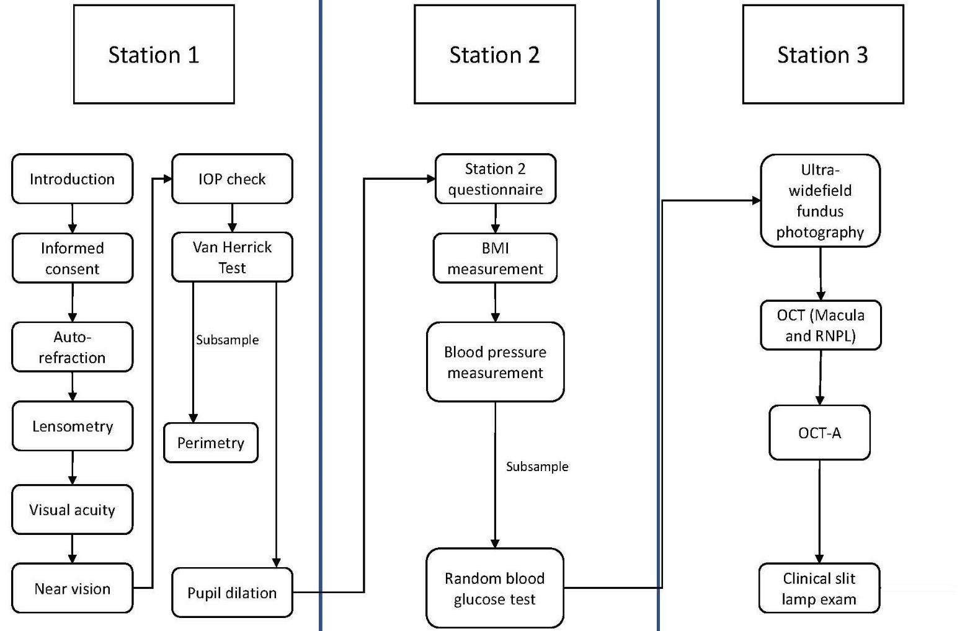
Examination Stations

Slide 11
Station Questionnaires
NEHS

Slide 12
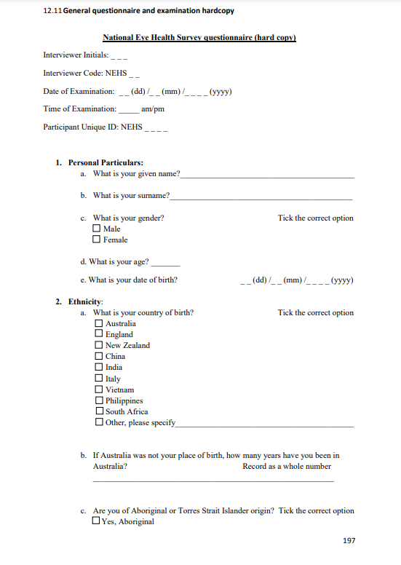
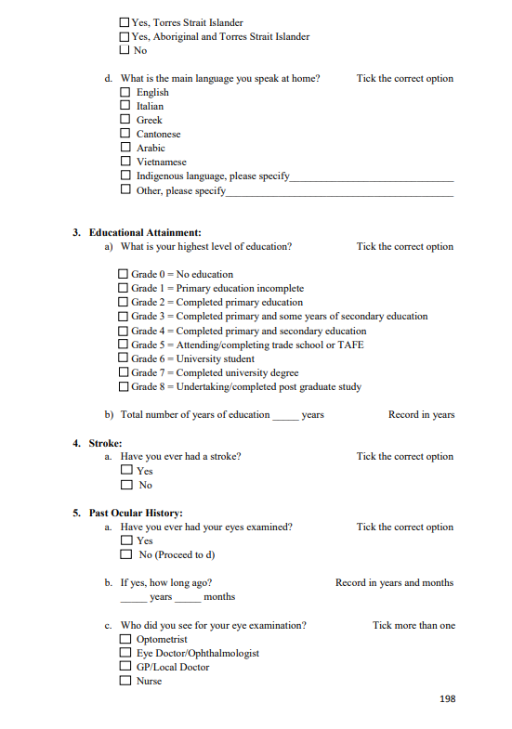

Slide 13
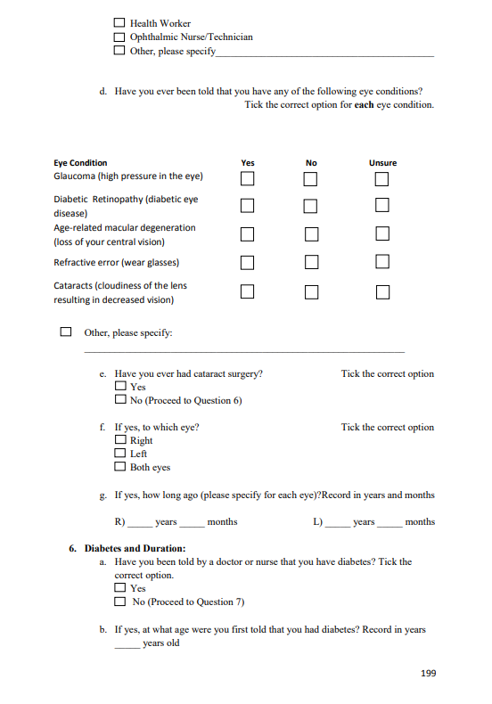
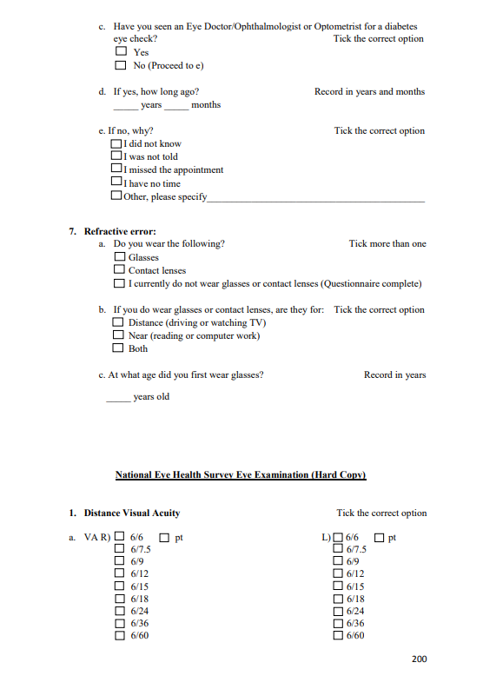

Slide 14
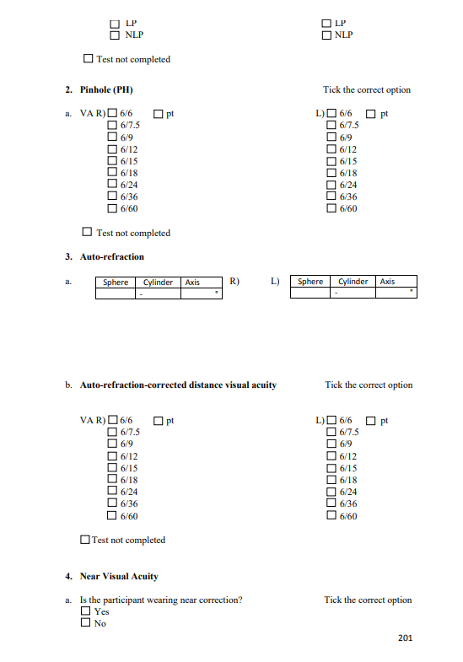
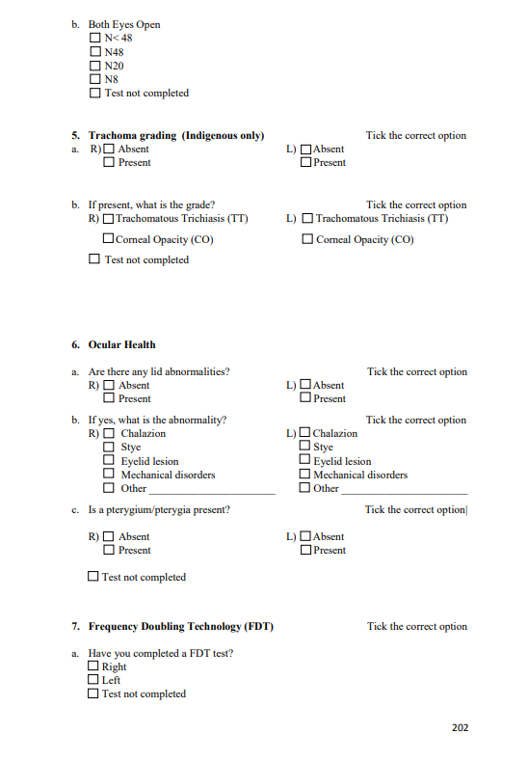

Slide 15
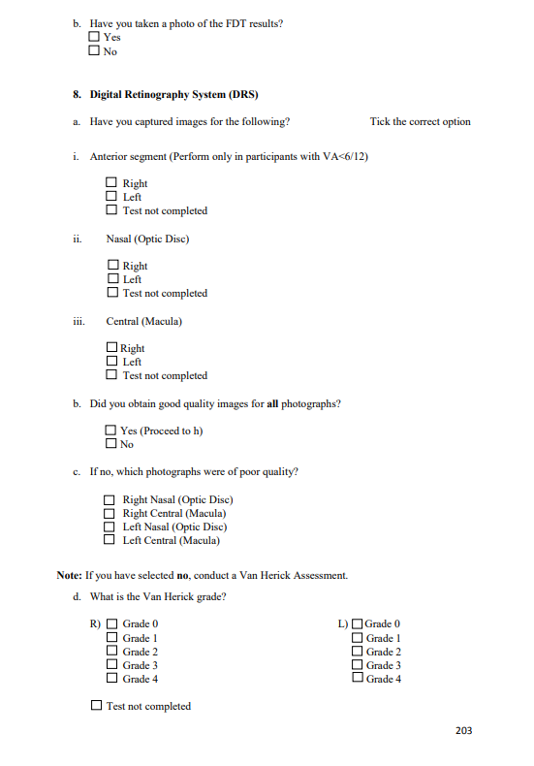
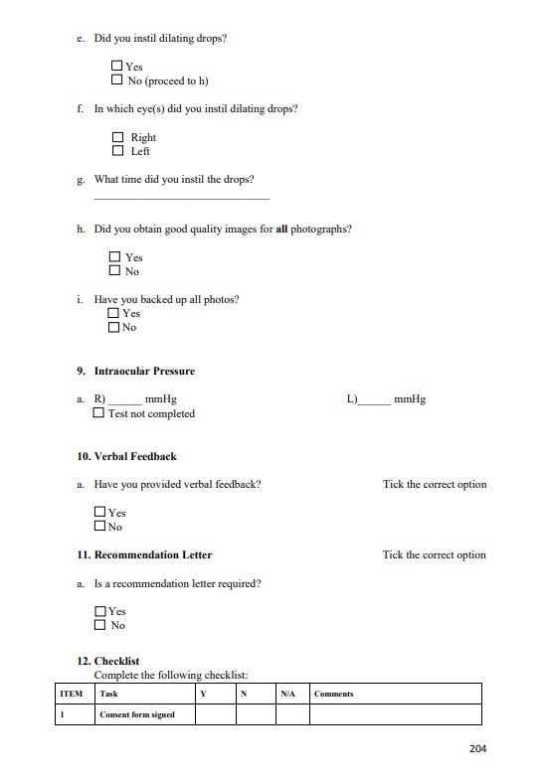

Slide 16
Station Questionnaires
AEHS

Slide 17
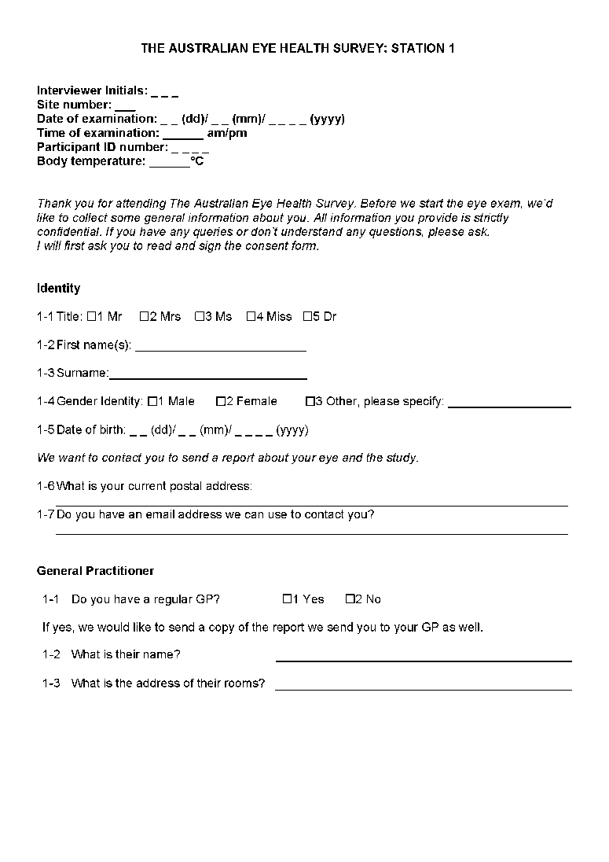
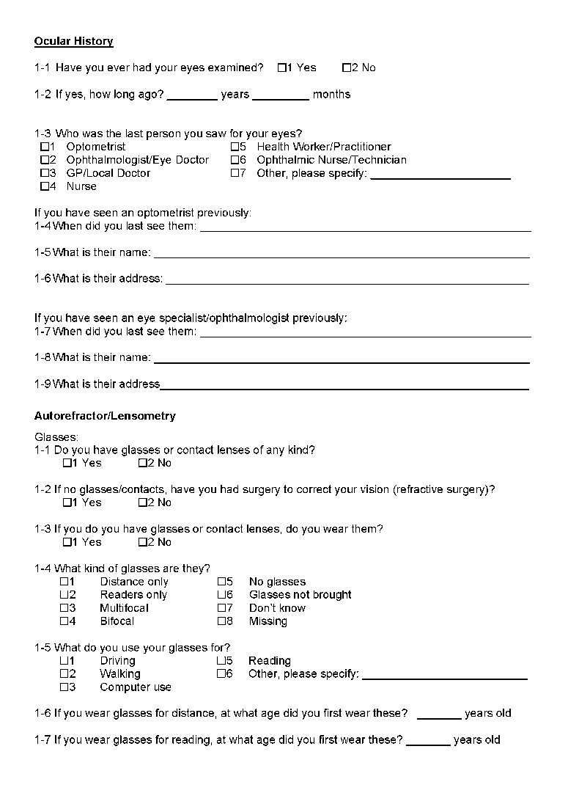

Slide 18
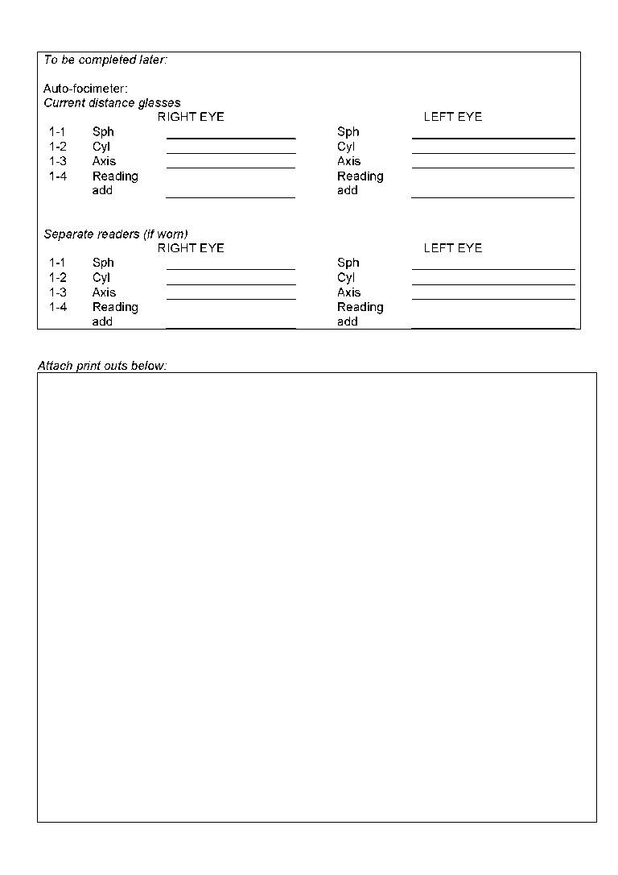
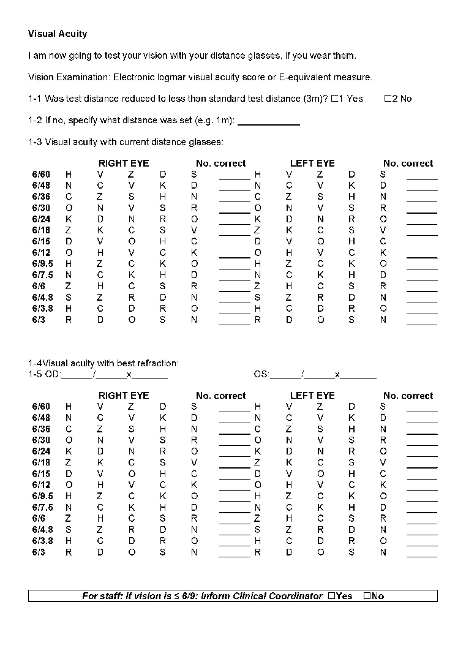

Slide 19
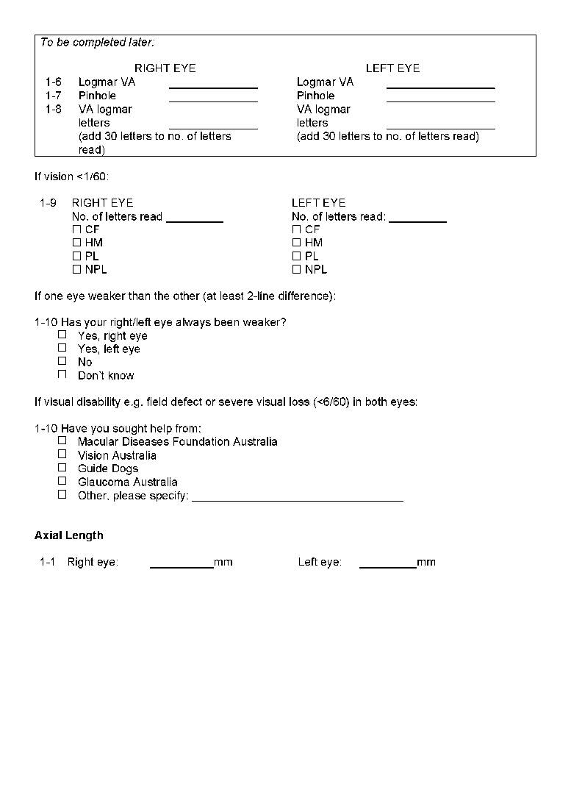

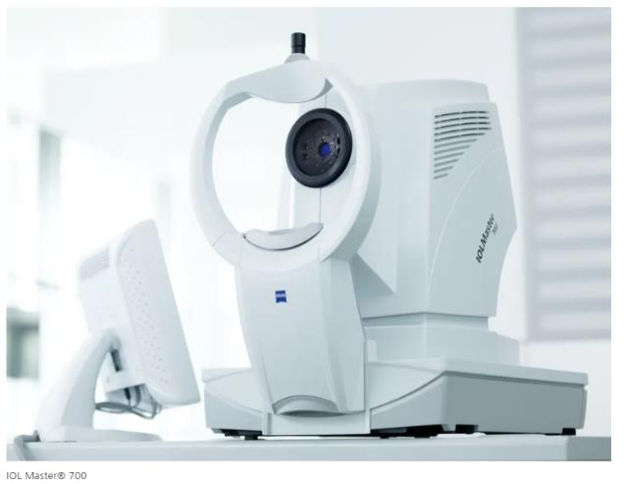

Zeiss IOL Master – axial length

Slide 20
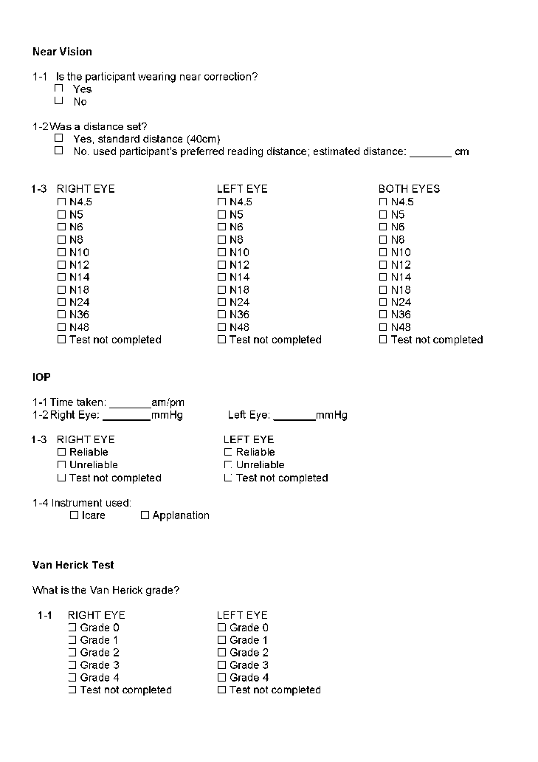
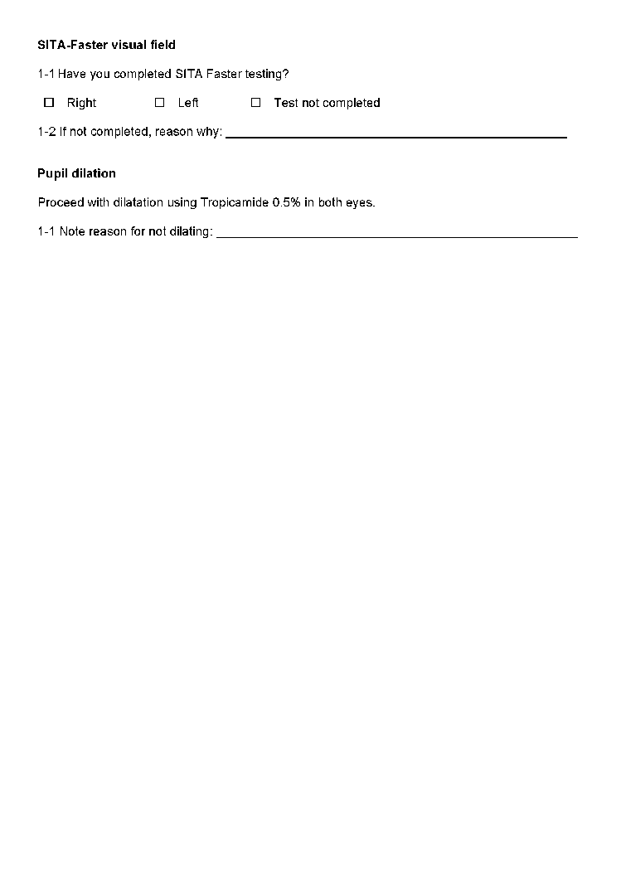
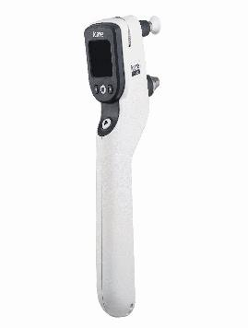
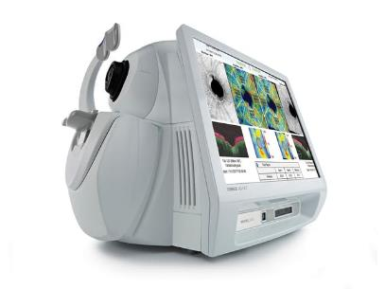
Zeiss Field Analyser 3; threshold visual fields. SITA 24-2 Faster
I-Care

Slide 21
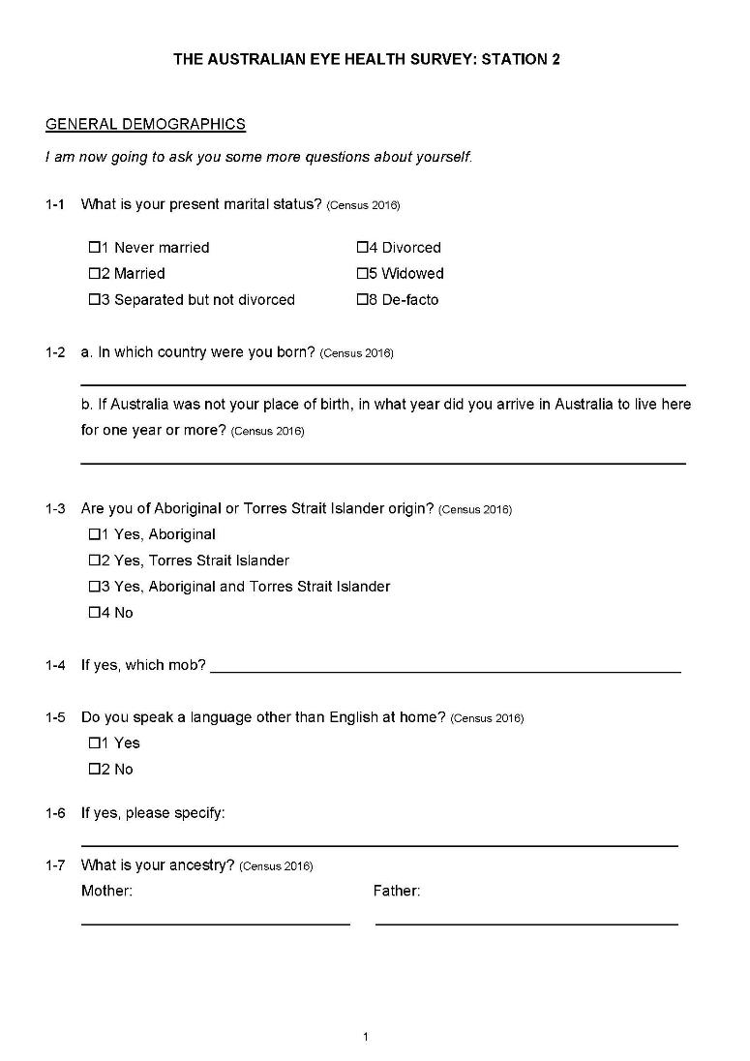
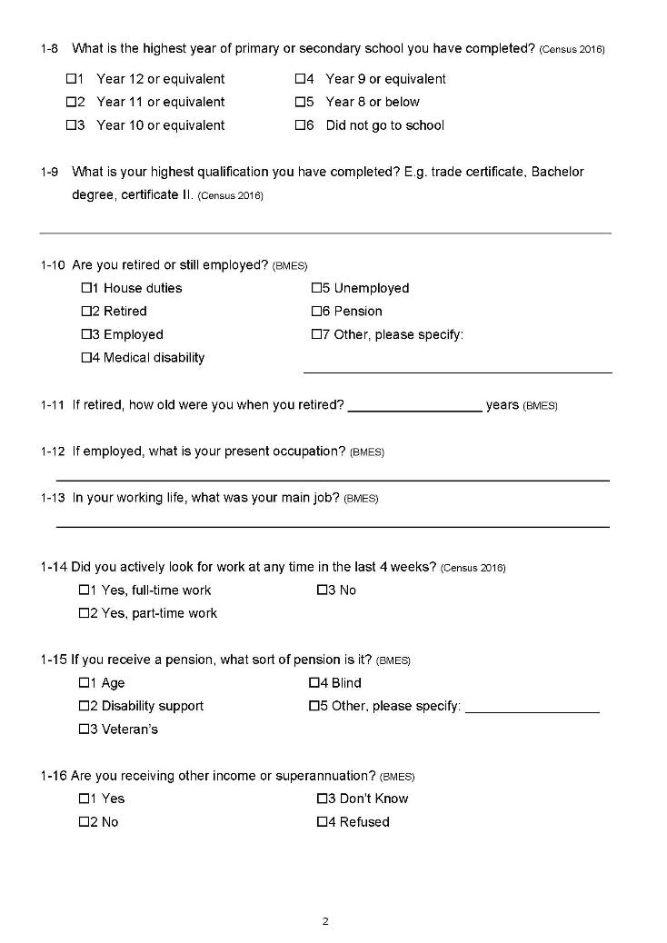

Slide 22
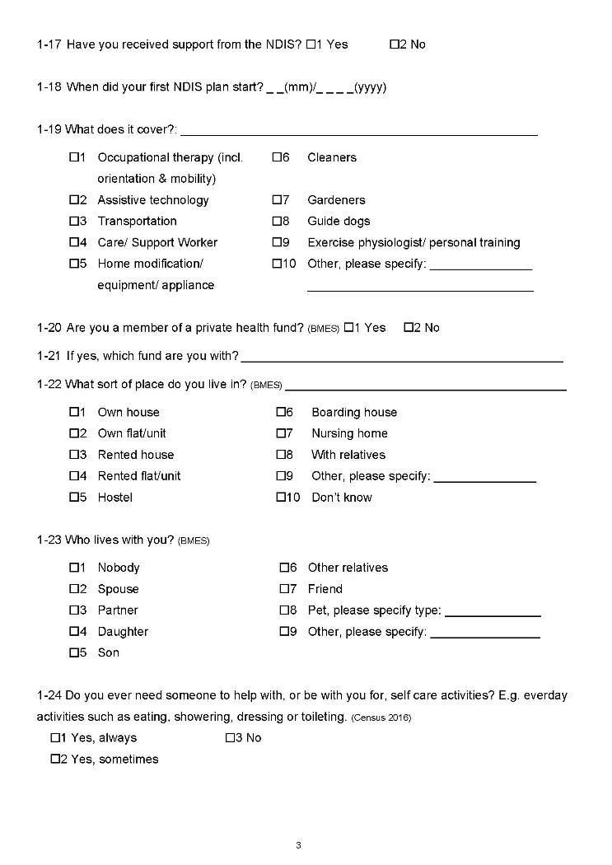
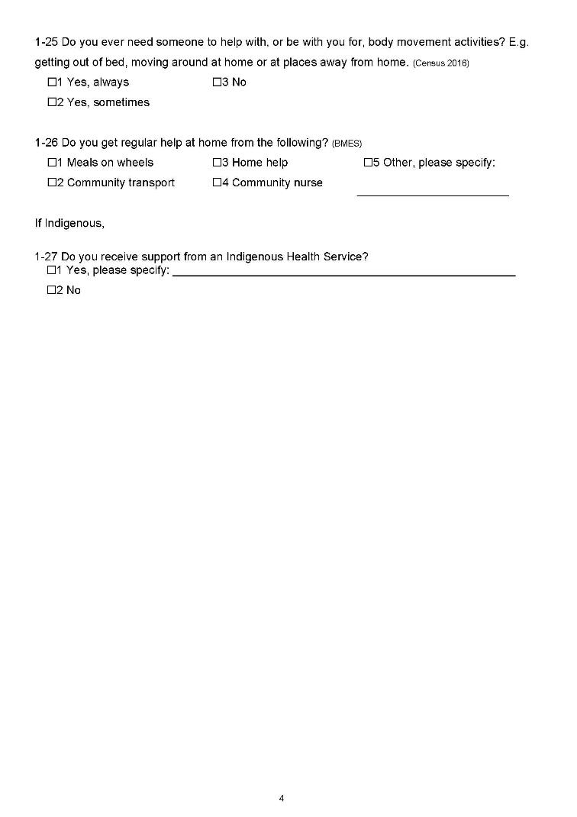

Slide 23

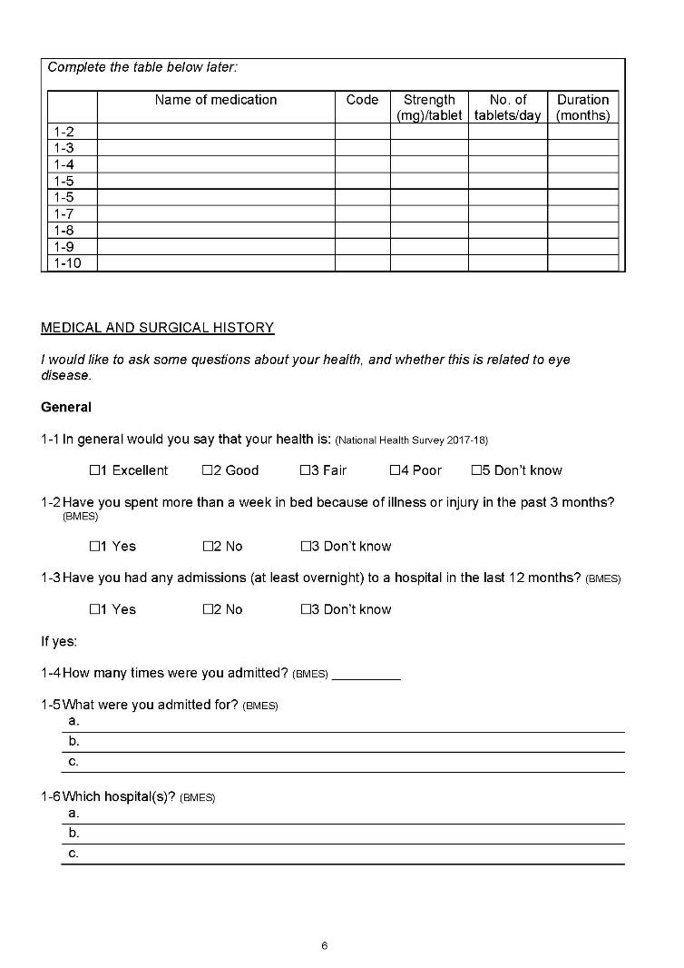

Slide 24
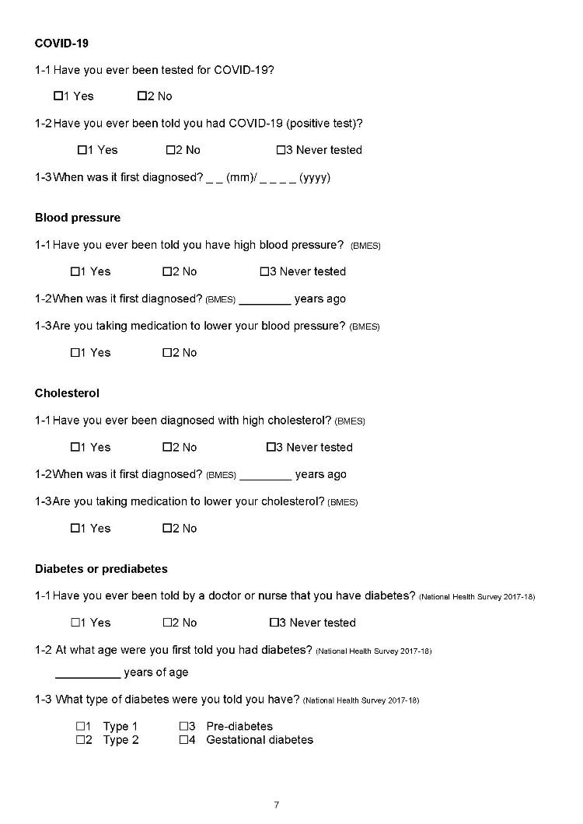
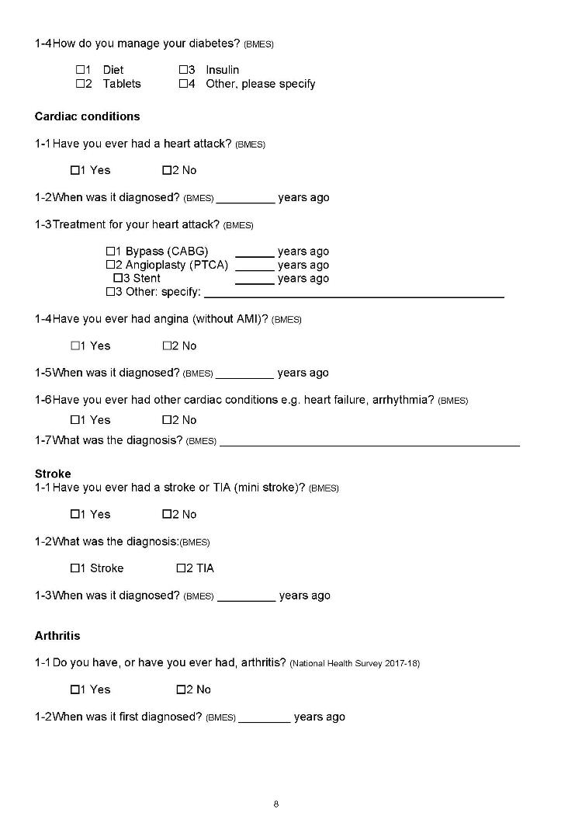

Slide 25
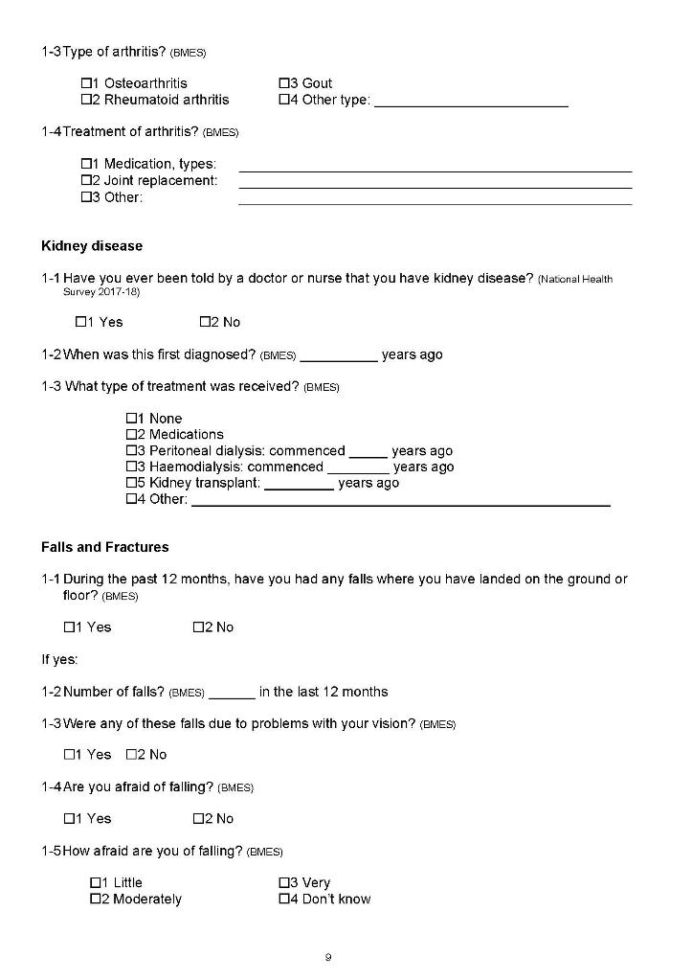
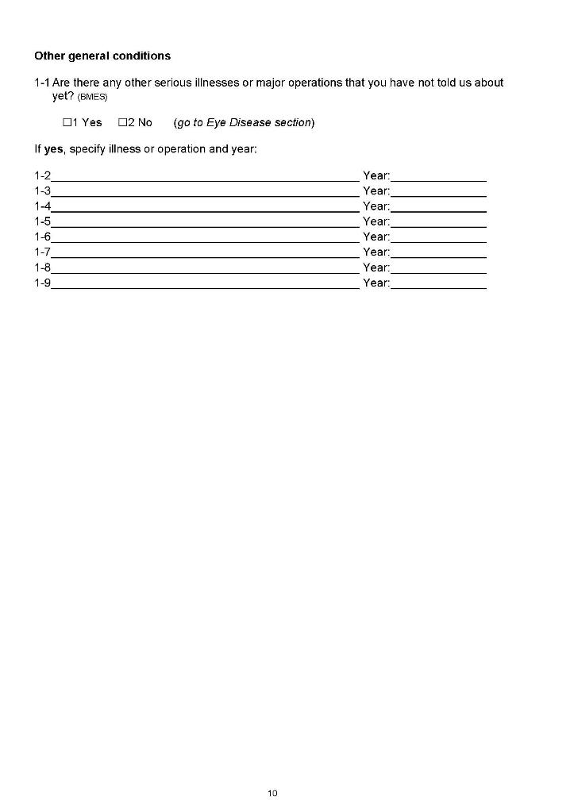

Slide 26
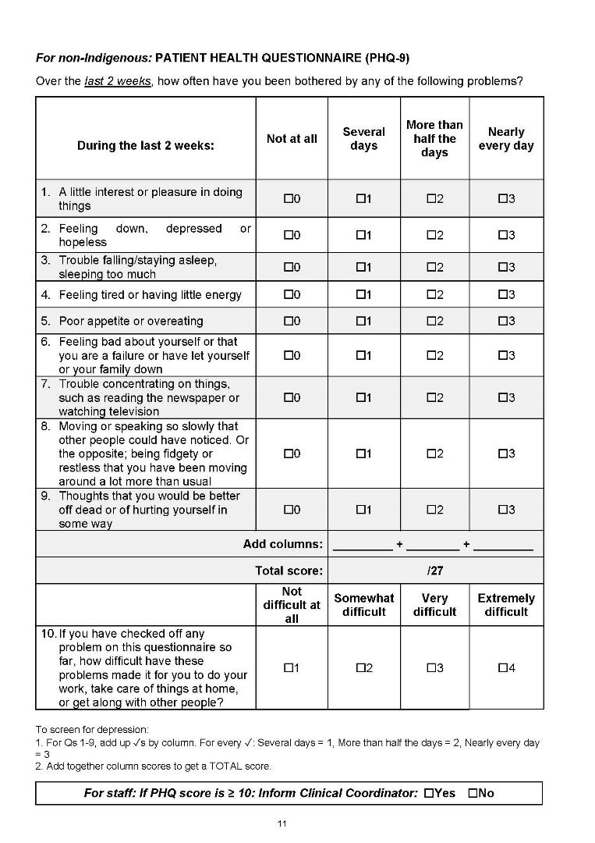
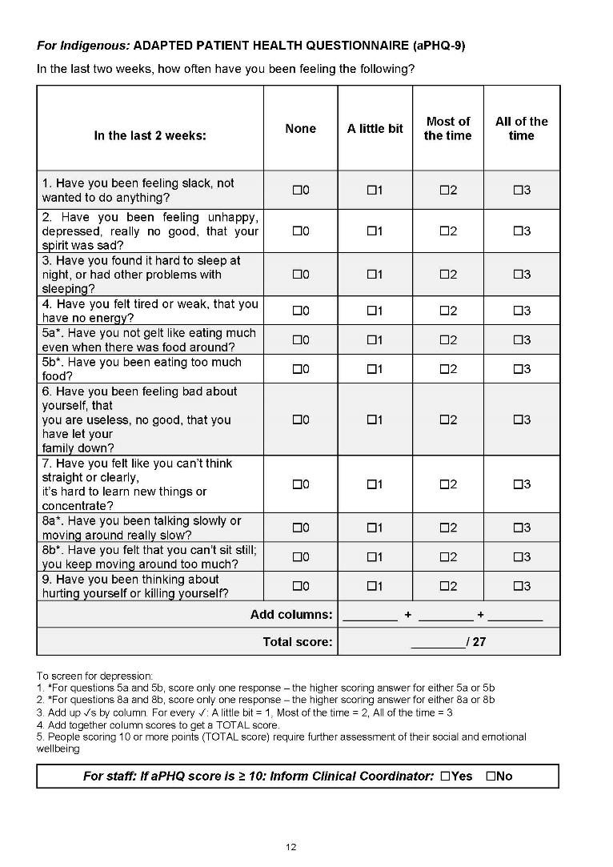

Slide 27
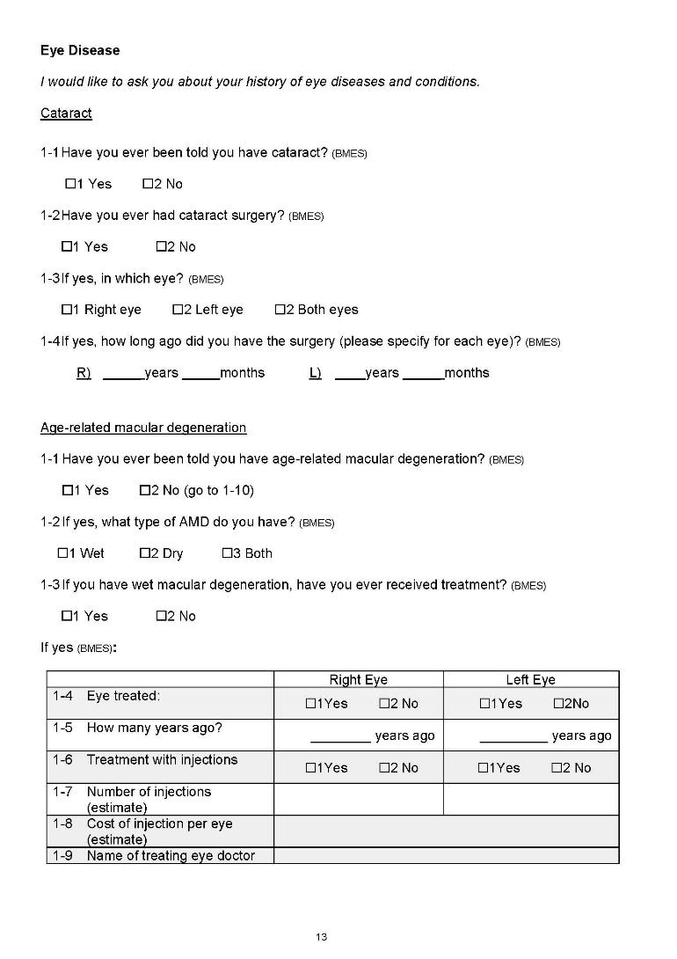
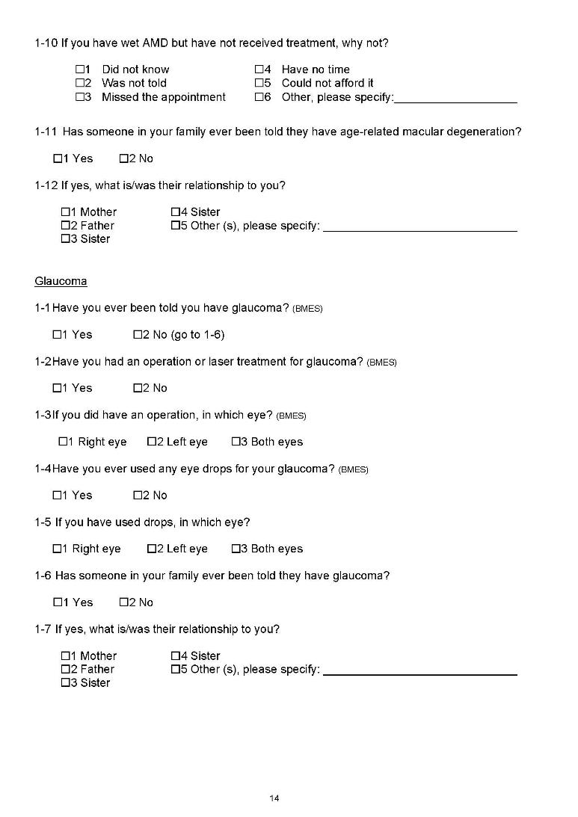

Slide 28
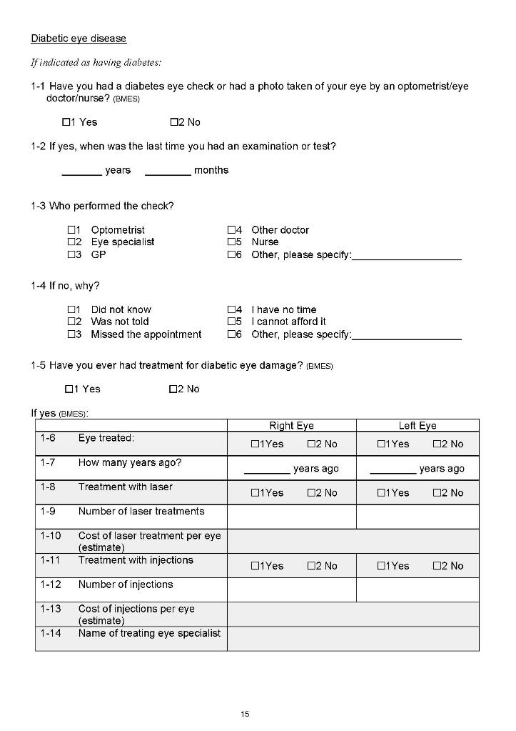
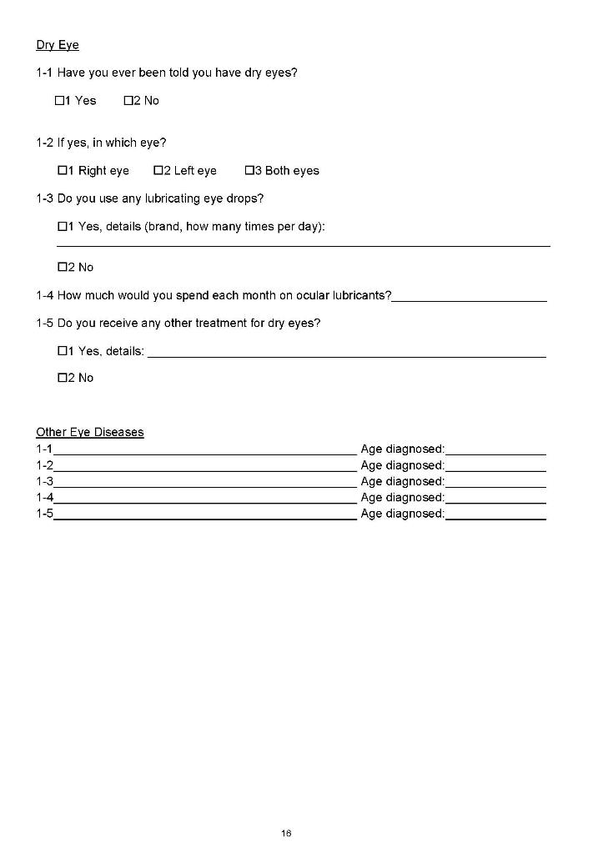

Slide 29
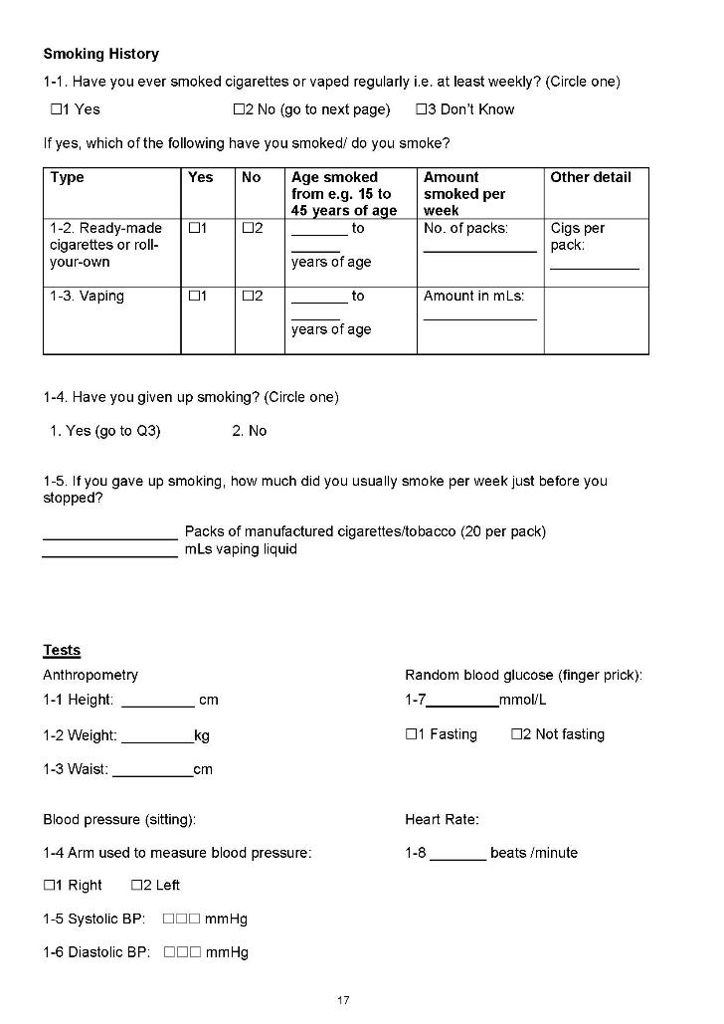

Slide 30
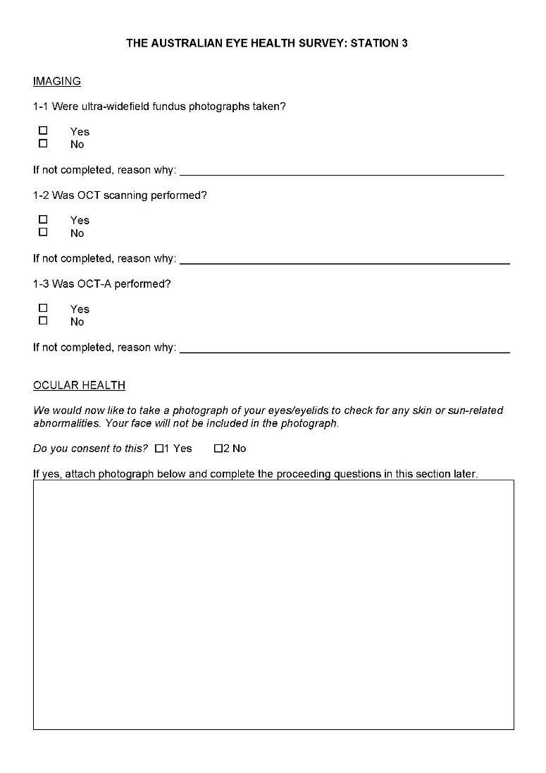
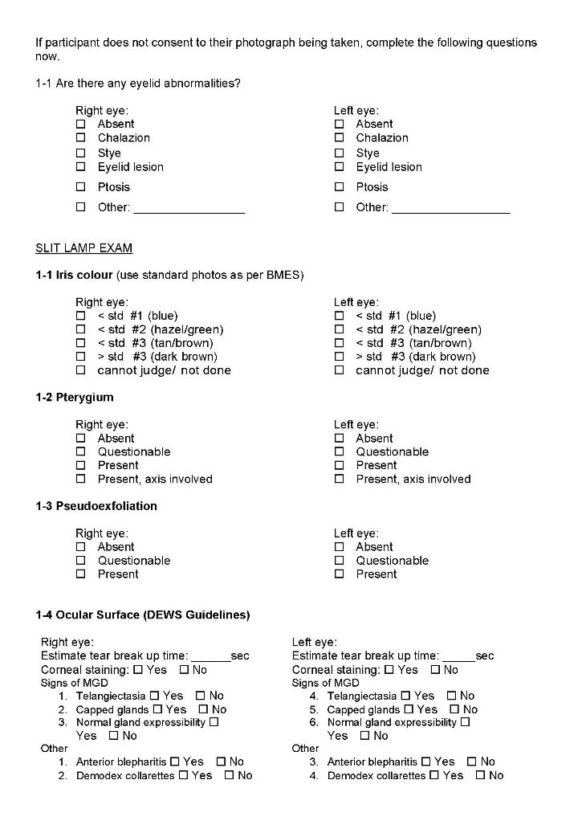

Slide 31
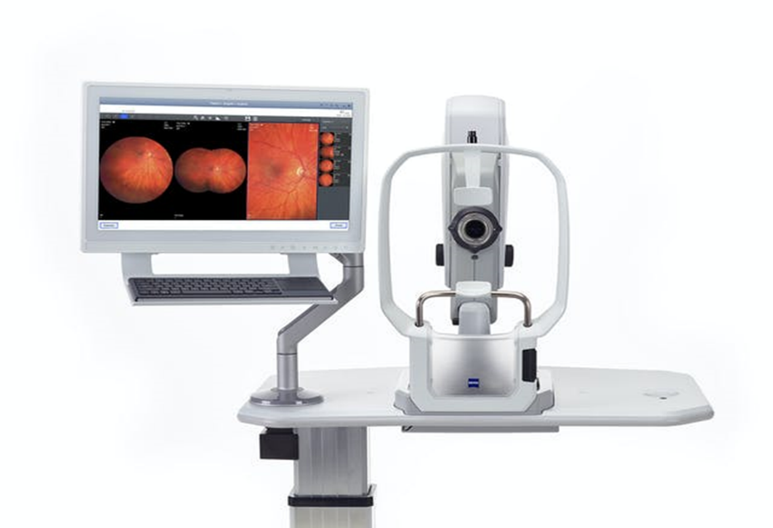
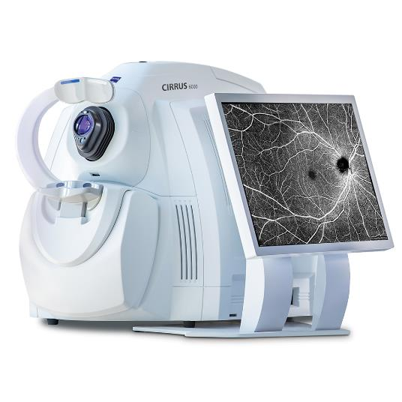
Equipment & Protocol
Zeiss OCT Cirrus 6000 with angiography module
Zeiss Clarus 700 Ultrawide field camera

Slide 32
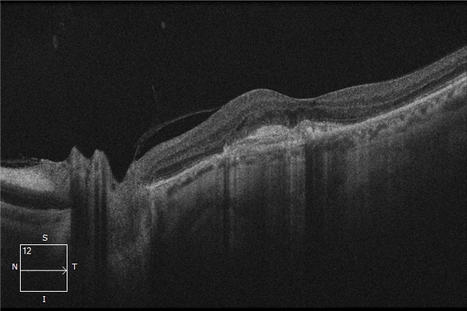
CIRRUS OCT 6000 Macular cube, OCT HD 21 line
Optic disc

Slide 33
CIRRUS 6000 OCT angiography
3 mm, 6 mm, 12 mm, montage

Slide 34
CLARUS 700

Slide 35
CLARUS 700

Slide 36
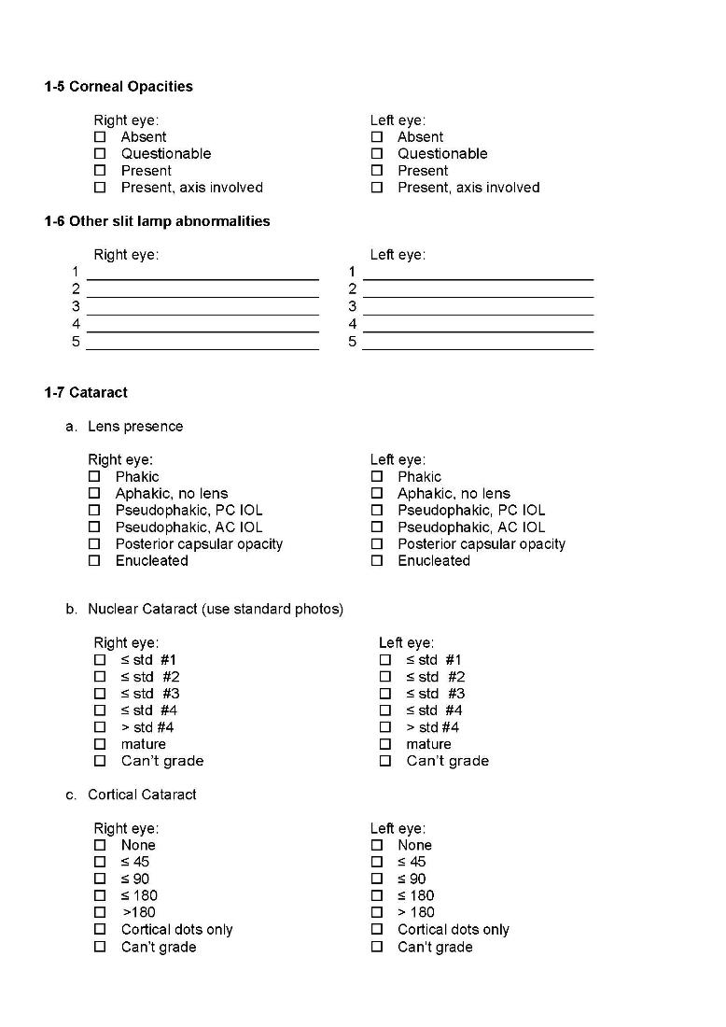
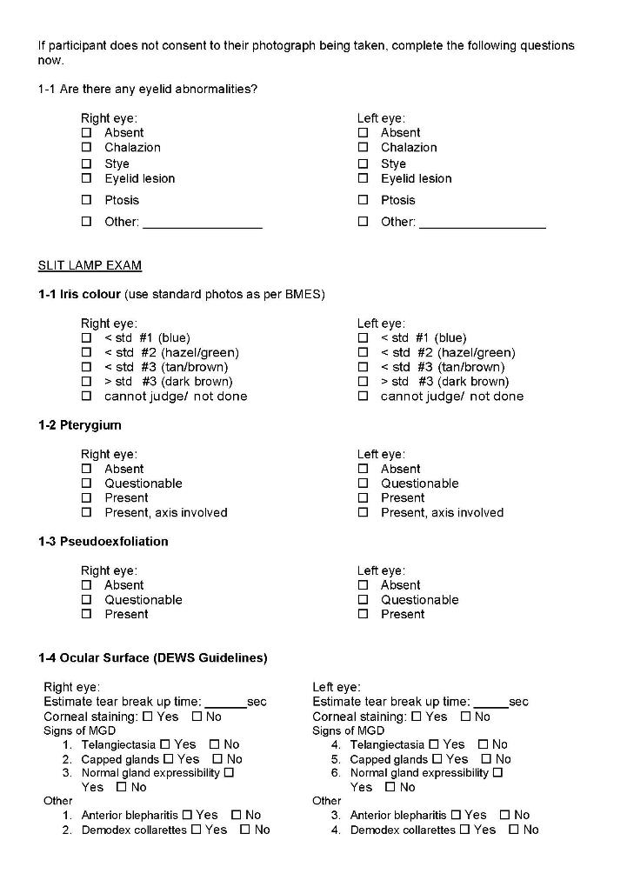
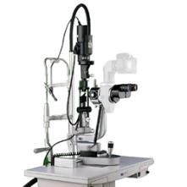

Slide 37
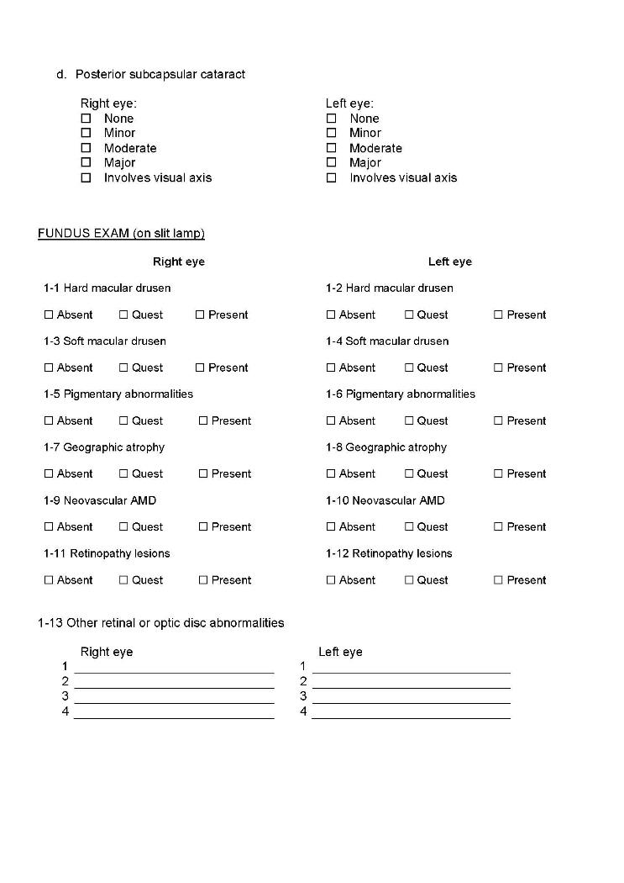
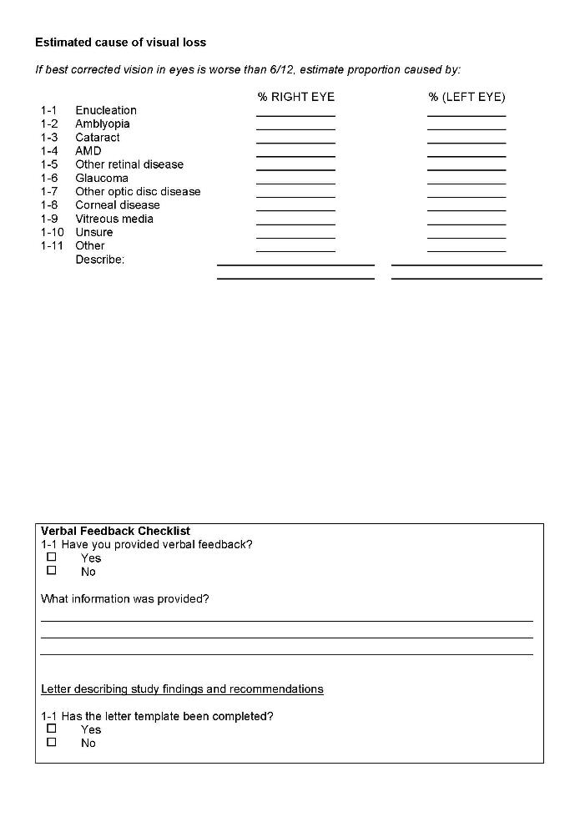

Slide 38
Take-home Questionnaire
…in booklet, or online
National Eye Institute Vision Function Questionnaire (NEI-VFQ)
(Ocular Surface Disease Index (OSDI))
Health Outcomes: EQ-5D-5L, EQ-5D Visual Analogue Scale
(Fatigue Severity Scale)
(Incidental and Planned Exercise Questionnaire (IPEQ))
(Food Frequency Questionnaire)
possible
(Activities of Daily Living)
(Depression scale (e.g. CESD-10))

Slide 39
Site Selection
Sampling strategy uses Census 2016 and geographic data to select sites
General Australian population distribution according to Census 2016:
  66% SA2 major cities
  21% inner regional
  10% outer regional
  2% remote
  1% very remote
Australia’s Indigenous population:
  35% major cities
  22% inner regional
  22% outer regional
  7.7% remote
  14% very remote

Slide 40
Methodology of the AEHS
Selection of SA2’s to represent State/ Australian population to enable recruitment of 3,250 N-I and 1,750 I
Selection of number of SA1’s within each SA2, in order to provide these targets – some SA2’s will include more SA1’s
Community publicity to selected SA2’s including to all eye care and general practitioners
Door-to-door census of selected SA1’s: Census 2016 maps
Identification of target population samples at each site
Invitation to attend examination at local centre
Persistent efforts to maximise exams of target individuals
Detailed eye exam with reports/ images/ recommendations sent to participants/ eye care/ general practitioners
Stepwise consent for exam, dilation, data linkage

Slide 41
Proportional allocation of sites if survey matched Australian population:
19 Major City
7 Inner Regional
3 Outer Regional
1 Remote/VR
State | Remoteness | Propn. of Aust. Pop’n | Proport. allocation to 30 sites | Nominated number sites
NSW/ACT | Major City | 23.77% | 7.1 | 7
NSW/ACT | Inner Regional | 6.81% | 2.0 | 2
NSW/ACT | Outer Regional | 2.61% | 0.8 | 1
NSW/ACT | Remote | 0.27% | 0.1 | -
NSW/ACT | Very Remote | 0.06% | 0.0 | -
VIC | Major City | 18.60% | 5.6 | 5
VIC | Inner Regional | 5.80% | 1.7 | 2
VIC | Outer Regional | 1.28% | 0.4 | -
VIC | Remote | 0.08% | 0.0 | -
VIC | Very Remote | - | - | -
QLD | Major City | 11.97% | 3.6 | 4
QLD | Inner Regional | 4.48% | 1.3 | 1
QLD | Outer Regional | 2.94% | 0.9 | 1
QLD | Remote | 0.77% | 0.2 | -
QLD | Very Remote | 0.55% | 0.2 | -
SA | Major City | 4.64% | 1.4 | 1
SA | Inner Regional | 1.03% | 0.3 | 1
SA | Outer Regional | 0.82% | 0.2
SA | Remote | 0.23% | 0.1
SA | Very Remote | 0.06% | 0.0
WA | Major City | 7.35% | 2.2 | 2
WA | Inner Regional | 1.23% | 0.4
WA | Outer Regional | 0.80% | 0.2 | 1
WA | Remote | 0.45% | 0.1
WA | Very Remote | 0.31% | 0.1
NT | Major City | - | -
NT | Inner Regional | - | -
NT | Outer Regional | 0.52% | 0.2
NT | Remote | 0.20% | 0.1 | 1
NT | Very Remote | 0.20% | 0.1
TAS | Major City
TAS | Inner Regional | 1.37% | 0.4 | 1
TAS | Outer Regional | 0.71% | 0.2
TAS | Remote | 0.08% | 0.0
TAS | Very Remote | 0.01% | 0.0
 |  | 100% | 30 | 30

Slide 42
16 Major City; 8 Inner Regional; 2 Outer Regional;
4 Remote/ Very Remote
State | Remoteness | SA2 name | Prop. >50 years | Prop. >80 years | Prop. Indigenous
NSW/ACT | Major City | Toongabbie/ Constitution Hill | 33.4% | 5.4% | 1.3%
NSW/ACT | Major City | Bradbury-Wedderburn | 28.6% | 2.3% | 6.0%
NSW/ACT | Major City | Malabar - La Perouse - Chifley | 36.0% | 4.8% | 4.4%
NSW/ACT | Major City | Raymond Terrace | 36.1% | 4.1% | 8.1%
NSW/ACT | Major City | Castle Hill (East) | 48.2% | 16.9% | 0.2%
NSW/ACT | Major City | Erina-Green Point | 45.5% | 9.1% | 1.9%
NSW/ACT | Major City | Corrimal | 37.9% | 6.0% | 3.8%
NSW/ACT | Inner Regional | Blue mountains/ Wentworth Falls | 48.2% | 6.1% | 1.9%
NSW/ACT | Inner Regional | Forster-Tuncurry | 53.6% | 5.1% | 4.6%
NSW/ACT | Outer Regional | Forbes | 40.9% | 6.2% | 10.4%
VIC | Major City | Doncaster | 37.4% | 7.% | 0.2%
VIC | Major City | Keilor (East) | 39.5% | 7.2% | 0.2%
VIC | Major City | Geelong | 37.9% | 4.5% | 0.8%
VIC | Major City | Mornington | 46.1% | 8.2% | 0.6%
VIC | Inner Regional | Ballarat | 40.4% | 5.3% | 0.6%
VIC | Inner Regional | Wangaratta | 41.2% | 7.5% | 1.5%
VIC | Inner Regional | Stawell | 47.1% | 6.0% | 1.8%
QLD | Major City | Nambour | 36.6% | 5.3% | 3.3%
QLD | Major City | Riverview | 33.8% | 5.7% | 9.2%
QLD | Major City | Ipswich | 33.9% | 4.0% | 5.4%
QLD | Inner Regional | Kingaroy Region – North | 43.5% | 4.8% | 20.5%
QLD | Remote | Palm Island | 19.6% | 0.5% | 86.0%
QLD | Very Remote | Mount Isa Region | 31.3% | 1.3% | 24.1%
SA | Major City | North Haven | 42.7% | 5.1% | 2.8%
SA | Inner Regional | Murray Bridge | 37.8% | 5.5% | 4.6%
WA | Major City | Mandurah | 50.7% | 8.4% | 2.8%
WA | Outer Regional | Geraldton | 43.9% | 7.2% | 10.8%
WA | Remote | Broome | 26.2% | 0.9% | 20.9%
NT | Very Remote | Petermann-Simpson | 20.9% | 0.8% | 39.1%
TAS | Inner Regional | Devonport | 41.9% | 7.0% | 5.9%
 |  | 100% | 30 | 30

Slide 43
AEHS: Alternative Sites
NSW
  Major city: Woy Woy
VIC
  Major city: Rosebud-McCrae
QLD
  Outer Regional: Magnetic Island
SA
  Major City: Christie’s Beach
WA
  Inner Regional: Chidlow
  Major City: Pinjarra

Slide 44
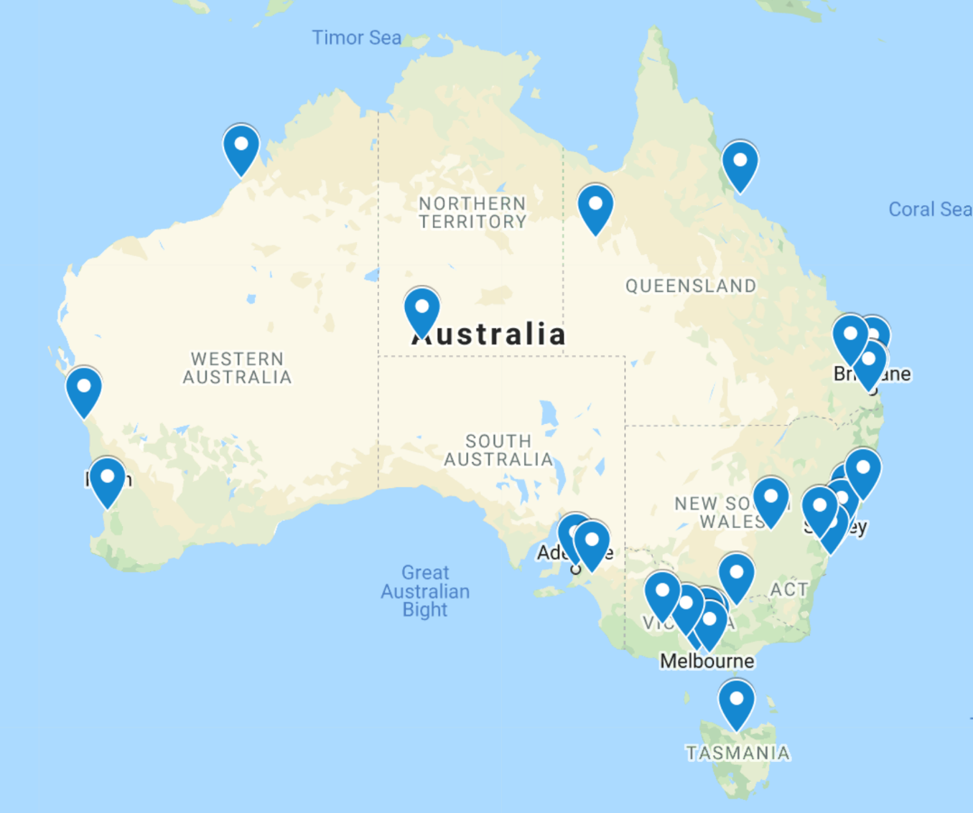

Slide 45
Australian Eye Health Study
Preferences and Constraints
COVID-19 – in practice, to maximise response, survey is unlikely to commence until Q3, 2021
  Consultation with Chief Medical Officer in each State
  Preparation by consultation with each state
Avoid non-sealed roads
Preference to sample reasonable number of city-based Indigenous persons
Greater (over-) sampling of older age groups to match Australia and key pathology

Slide 46
Australian Eye Health Study
Progress to Date and Plans
Steering Committee Members - applicants
Draft examination protocol, questionnaires, consent form, participant information statement, flyer
Submission ethics application to University of Sydney Human Ethics Committee; 4 November, 2020
Send to V2020 Aust. draft documents (questionnaires, consent forms, etc) for review; today
Finalise Advisory Committee membership
Finalise site selection (then select SA1s within SA2s); communicate to practitioners at each site
BHF will consult with primary Indigenous organisations for endorsement and ethics approval
Recruit staff, students
Purchase equipment

Slide 47
Australian Eye Health Study
Conclusions
Examinations will be longer (up to 1.5 hours vs 0.5 to 1)
Longer stay at each site (2-3 weeks vs 3-8 days)
Survey will take 18 mos (12), likely delayed by 6+ months
More detailed LogMAR vision assessment
More comprehensive questionnaire including risk factors and impacts, health outcomes; data linkage if consented
Dilated exam, if consented
Focus on more detailed ocular imaging, including OCT (macula/ optic nerve), OCTa, wide-field photography
Threshold visual field testing (SITA 24-2 Faster)
Anthropometry, blood pressure, finger-prick blood glucose
Welcome feedback

